Slide 1
Risk Analytics in Banking
and
Financial Services 1
Predict what are the high risk variables when lending to a client.
AWS PLATFORM

Slide 2



Presentor: Renee’ Garrett
www.linkedin.com/in/renee-garrett-42941963
Student at the Institute of Data
Science, Possessing a background in corporate banking investigation.

Slide 3
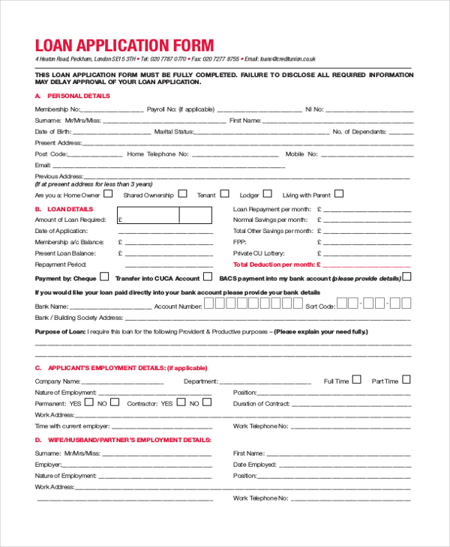
Objective:
Perform exploratory data analysis (EDA) to delve into risk analytics within the banking and financial services sector. The primary aim is to pinpoint high-risk variables linked with potential financial losses incurred during customer lending activities. By conducting thorough data exploration, utilize statistical methodologies and visualization techniques to unearth underlying patterns, trends, and correlations embedded within the dataset. Ultimately, the objective is to conduct model testing on key variables, enabling informed decision-making processes for lending institutions when evaluating client lending applications.

Slide 4
1. Intro
Clients application: Conducting a thorough data exploration.
Data Review banking data by examining loan application fields to gain insights into the characteristics and attributes of loan applicants.
Targeted Columns Through data exploration, columns such as "annuity,credit,good price,gender amount of income" are analyzed to uncover key factors that agents should consider during loan decision-making processes.

Slide 5

Client:
I am looking for a Loan.
What information is needed from client.

Slide 6
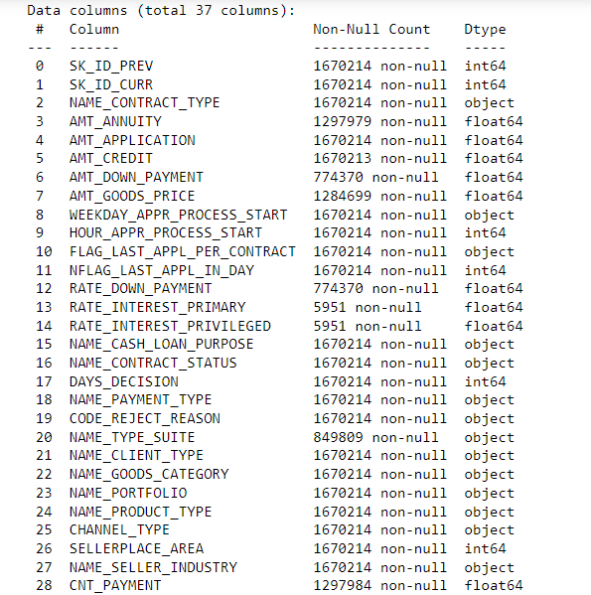
Captured Data.
Excel: Application csv file,
Featured Columns:

Slide 7
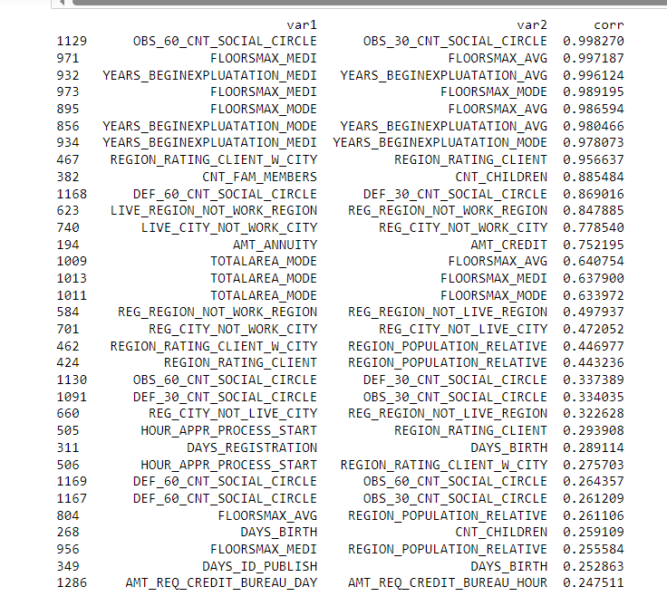
Defaulters.corr

Slide 8


To understand client patterns, we will analyze previous data collected to identify trends and make informed decisions. By mitigating risk factors and satisfying our stakeholders, we aim to enhance decision-making processes.
Files
Application data from client:
App_csv = 'application_data.csv’
Dictionary:
Columns_description_csv = "columns_description.csv "

Slide 9
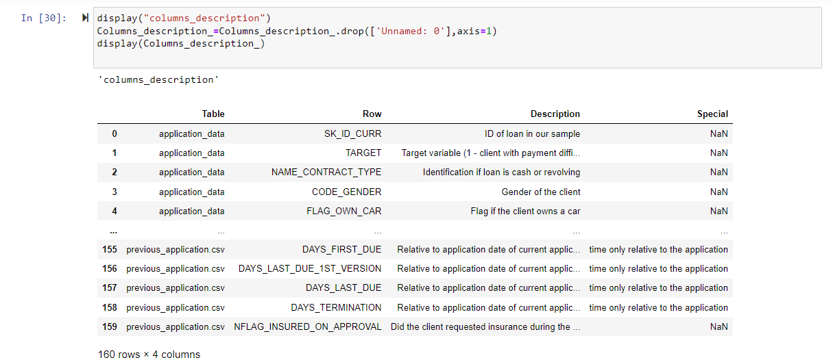
Dictionary of data variables.
columns_description.csv

Slide 10
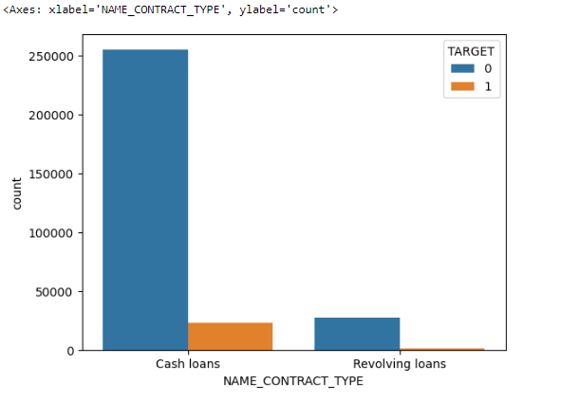
Name Contrat Type.
What type of loan the client requesting.

Slide 11
During the application intake process, the data analysis reveals several key insights:
Cash Loan vs. Revolving Loans:
Majority of customers have opted for cash loans.
Customers who have taken cash loans are less likely to default.
Code Gender:
Over 60% of the female population, who have taken the loan, are less likely to default compared to males.
Male population, comprising half the women population, shows a slightly higher risk.
Name Type Suite:
Clients who applied unaccompanied are less likely to default, with a default rate of 8%.
Name Income Type / Client Profession:
Safest clients belong to the categories of working individuals, commercial associates, and pensioners, exhibiting low default rates.
Name Education Type:
Clients with higher education levels are less likely to default, with a default rate of less than 6%.
Name Family Status:

Slide 12
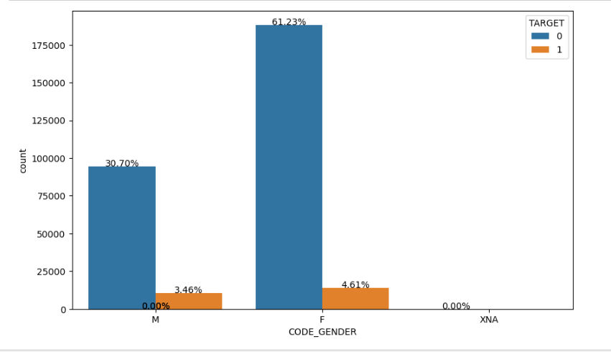
Gender Comparison.

Slide 13
Name Family Status:
Married families are less likely to default among the clients who are given loans.
Name Housing Type:
Clients owning their own house/apartment have a lower default rate (7%).
Occupation Type:
Low-skill laborers are the highest defaulters, while core staff, managers, and laborers exhibit lower default rates (7-10%).
Weekday Appr Process Start:
No significant effect observed based on the day of the week when the client applied for the previous application.
Organization Type:
Transport-related organizations exhibit the highest default rates, while others, business entity type 3, and self-employed individuals are safer to loan to with default rates around 10%.
Other Observations:
Clients with loan amounts between 0-1 million are likely to default.
Majority of customers pay annuities between 0-50k.
Clients with income less than or equal to 1 million are more likely to apply for loans, with a default risk increasing for those with credit amounts less than 1.5 million.
Customers with 5 or more children are more likely to default.
Clients with 1.5 children or fewer are less likely to default when loaned credits.
Conclusion:

Slide 14
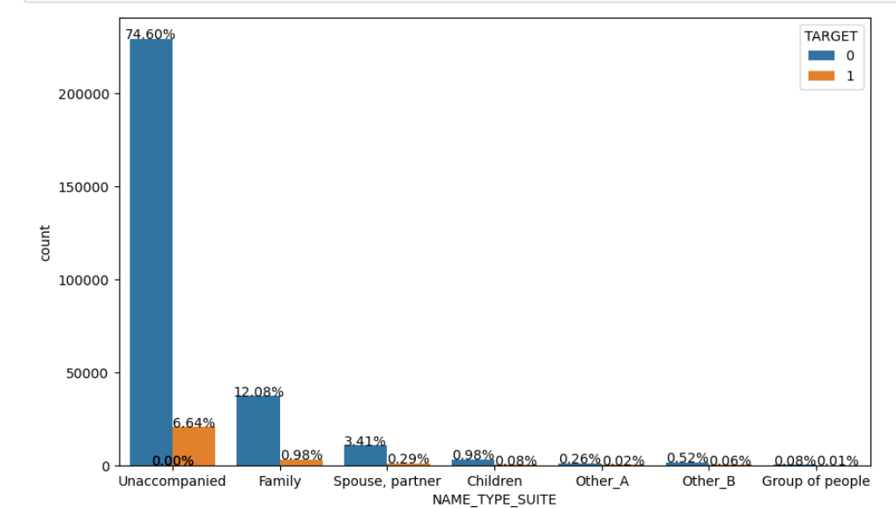
Conclusion:
Clients who can afford annuities of around 100k are likely to get the loan, which falls within the "safe zone" of less than 2 million. In comparing merged data, it's noted that applications requiring repairs may lead to cancellations by clients, as there is an equal representation of refusals and cancellations.

Slide 15

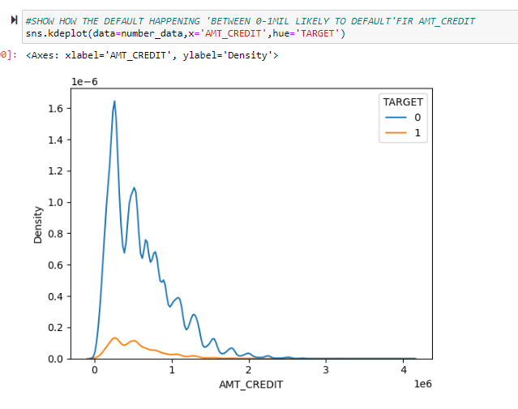
FLAG.

Slide 16
Based on the data analysis, here are some concise recommendations:
Tailored Loan Products:
Develop loan products tailored to the preferences of cash loan customers, who show lower default rates.
Gender-Specific Strategies:
Implement gender-specific strategies to attract male customers while mitigating their slightly higher default risk.
Client Accompaniment:
Encourage client accompaniment during the application process to reduce default rates, especially for unaccompanied applicants.
Occupation-Based Risk Assessment:
Assess default risk based on occupation and adjust loan terms accordingly.
Family Status Consideration:
Offer incentives to married families, who exhibit lower default rates, to attract more of them.
Housing Status Verification:
Verify housing status and offer favorable terms to clients owning their own homes, as they have lower default rates.
Income Verification:
Prioritize clients with higher incomes, as they are less likely to default on loans.
Children Dependence:
Consider the number of dependent children when assessing loan applications.
Loan Amount Limitations:
Limit loan amounts for clients with higher default risks, particularly those with loan amounts between 0-1 million.
Client Support and Communication:
Provide support during the application process, especially for applications requiring repairs, to minimize cancellations and refusals.
Continuous Monitoring:
Monitor loan performance regularly and adjust lending strategies based on emerging trends to minimize default risks.
Implementing these recommendations can help optimize lending practices and improve portfolio performance.

Slide 17

References:
Data set:
Risk Analytics In Banking & Financial Services 1 | Kaggle
youtube - Search (bing.com)

